Slide 1
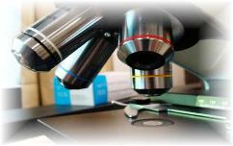
About Science Prof Online
PowerPoint Resources
Science Prof Online (SPO) is a free science education website that provides fully-developed Virtual Science Classrooms, science-related PowerPoints, articles and images. The site is designed to be a helpful resource for students, educators, and anyone interested in learning about science.
The SPO Virtual Classrooms offer many educational resources, including practice test questions, review questions, lecture PowerPoints, video tutorials, sample assignments and course syllabi. New materials are continually being developed, so check back frequently, or follow us on Facebook (Science Prof Online) or Twitter (ScienceProfSPO) for updates.
Many SPO PowerPoints are available in a variety of formats, such as fully editable PowerPoint files, as well as uneditable versions in smaller file sizes, such as PowerPoint Shows and Portable Document Format (.pdf), for ease of printing.
Images used on this resource, and on the SPO website are, wherever possible, credited and linked to their source. Any words underlined and appearing in blue are links that can be clicked on for more information. PowerPoints must be viewed in slide show mode to use the hyperlinks directly.
Several helpful links to fun and interactive learning tools are included throughout the PPT and on the Smart Links slide, near the end of each presentation. You must be in slide show mode to utilize hyperlinks and animations.
This digital resource is licensed under Creative Commons Attribution-ShareAlike 3.0:
http://creativecommons.org/licenses/by-sa/3.0/
Alicia Cepaitis, MS
Chief Creative Nerd
Science Prof Online
Online Education Resources, LLC
alicia@scienceprofonline.com
Tami Port, MS
Creator of Science Prof Online
Chief Executive Nerd
Science Prof Online
Online Education Resources, LLC
info@scienceprofonline.com
From the Virtual Biology Classroom on ScienceProfOnline.com
Image: Compound microscope objectives, T. Port
Notes:
Welcome to Science Prof Online PowerPoint Resources!
This PowerPoint Presentation comes from the Virtual Cell Biology Classroom of Science Prof Online, and, as such, is licensed under Creative Commons Attribution-ShareAlike 3.0.; meaning you can download, share and alter any of this presentation, but you can’t sell it or repackage and sell any part of it. Please credit Science Prof Online as the source of this presentation. Please abide by credited image copyrights. Thank you for using this resource.

Slide 2
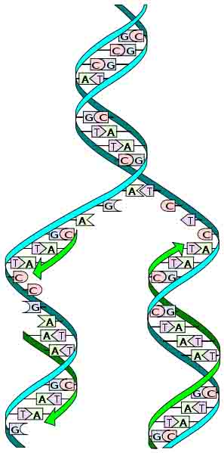
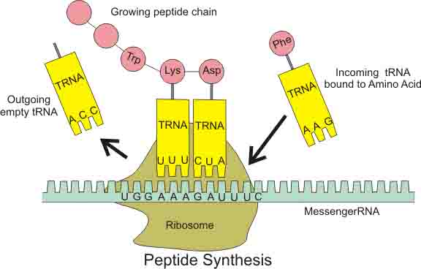
Molecular
Genetics
Basics
Image: Peptide Synthesis Diagram: Boumphreyfr, Wiki; Replication Diagram: Madprime, Wiki
From the Virtual Biology Classroom on ScienceProfOnline.com

Slide 3
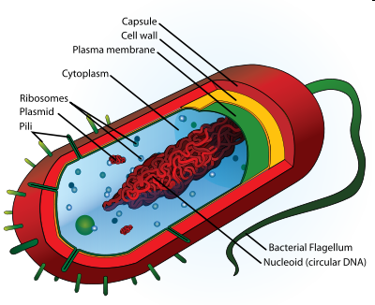
Prokaryotic Genomes
Made of DNA
Chromosomes can be circular or linear
Genome floats freely within cytoplasm
Q: Where is DNA found in prokaryotes?
  ______________
  ______________
From the Virtual Biology Classroom on ScienceProfOnline.com
Image: Prokaryotic Cell Diagram: Mariana Ruiz
Notes:
Nucleoid
Plasmids

Slide 4
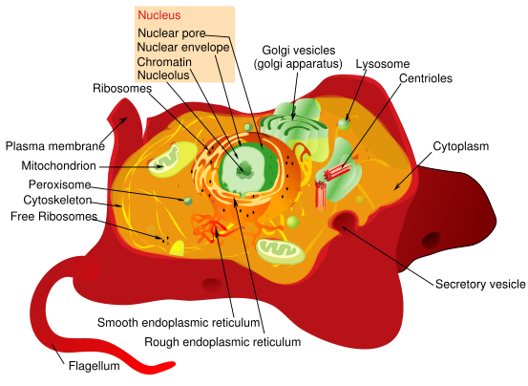
Eukaryotic Genomes
Genomes of eukaryotic organisms made of DNA.
Eukaryotic genomes frequently include many linear chromosomes within a membrane-bound nucleus
(Q: How many do we have?).
Where is DNA found in eukaryotes?
  Nuclear DNA
  Extranuclear DNA
  (Q: What is extranuclear DNA?)
From the Virtual Biology Classroom on ScienceProfOnline.com
Image: Eukaryotic Cell Diagram, Mariana Ruiz
Notes:
Eukaryotic

Slide 5
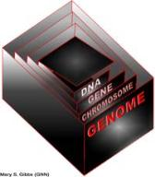
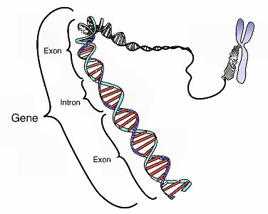
Chromosomes & Genes
Genome - Complete complement of an organism’s DNA.
Cellular DNA is organized in chromosomes.
Genes have specific places on chromosomes.
Image: Chromosome & gene, Graham Colm, National Human Genome Research Institute
From the Virtual Biology Classroom on ScienceProfOnline.com

Slide 6
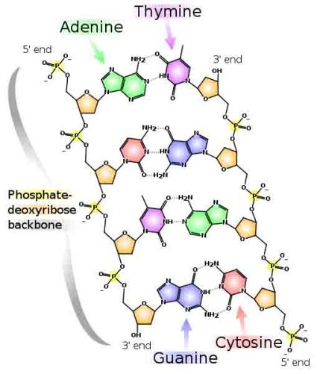
Nucleotides
and
Nucleic Acids
From the Virtual Biology Classroom on ScienceProfOnline.com
Image: DNA Detail Diagram: Madprime

Slide 7
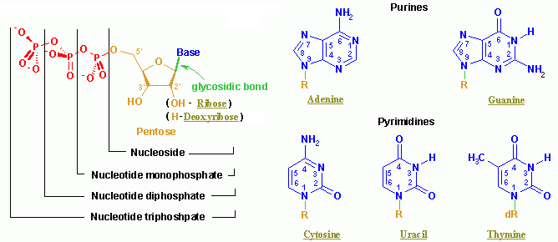
Nucleic Acids
Q: What type of monomer are nucleic acids made of?
From the Virtual Biology Classroom on ScienceProfOnline.com
Image: Nucleotide Structure, Wikipedia

Slide 8
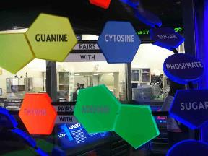
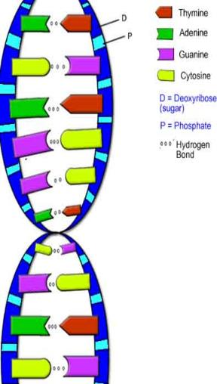

DNA Structure
Double stranded molecule, analogous to a spiral staircase:
- two deoxyribose-phosphate chains as the “side rails”
- base pairs, linked by hydrogen bonds, are the “steps”
Purine Bases
(double ring)
Adenine & Guanine
Pyrimidine Bases
(single ring)
Cytosine & Thymine
Images: Model of DNA Molecule, Field Museum, Chicago, T. Port; DNA Detail Diagram: Madprime; DNA Molecule, Biology Corner
From the Virtual Biology Classroom on ScienceProfOnline.com

Slide 9
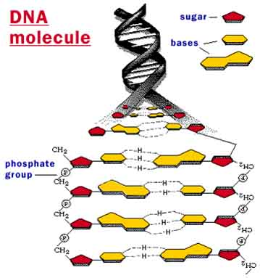
From the Virtual Biology Classroom on ScienceProfOnline.com
Image: DNA molecule, Why Files, NSF

Slide 10
DNA Replication
Copying of a double-stranded
DNA molecule.
Each DNA strand holds the same genetic information, so each strand can serve as a template for the new, opposite strand.
The parent (a.k.a. __________ )
strand is preserved and the daughter (a.k.a. ___________) strand is assembled from nucleotides.
This is called semi-conservative replication.
Resulting double-stranded DNA molecules are identical.
Q: Why would a cell need to copy its DNA?
From the Virtual Biology Classroom on ScienceProfOnline.com
Image: Replication Diagram: Madprime, Wiki
Notes:
template
new
semi-conservative

Slide 11

DNA Replication
In a cell, DNA replication must happen before cell division.
Prokaryotes replicate their DNA throughout the interval between cell divisions.
In eukaryotes, timing of replication is highly regulated.
From the Virtual Biology Classroom on ScienceProfOnline.com
Image: Prokaryotic Cell Diagram & Eukaryotic Cell Diagram, Mariana Ruiz

Slide 12
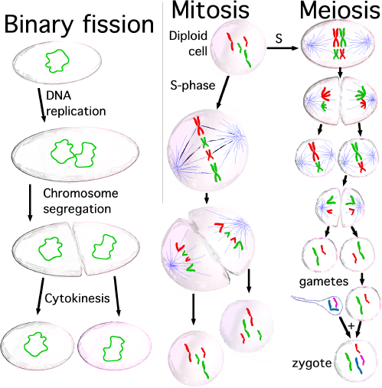
DNA Replication
From the Virtual Biology Classroom on ScienceProfOnline.com
Image: Types of Cell Division, Saperaud Wiki

Slide 13
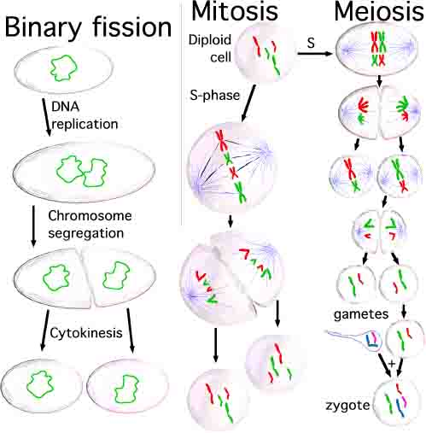
Reminder…Why is the DNA copied?
  Replication occurs prior to cell division, because the new, daughter cell will also need a complete copy of cellular DNA.
From the Virtual Biology Classroom on ScienceProfOnline.com
Image: Types of Cell Division, Saperaud Wiki

Slide 14
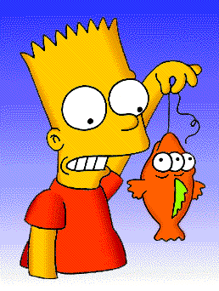
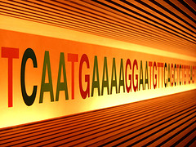
Replication Mistakes: Mutations of Genes
Change in the nucleotide base sequence of a genome; rare.
The problem: Wrong amino acid may result a non-functional Protein due to improper folding
Almost always bad news, but...
Rarely leads to a protein having a novel property that improves ability of organism and its descendants to survive and reproduce.
From the Virtual Biology Classroom on ScienceProfOnline.com
Images: Blinky & Bart, Matt Groening

Slide 15
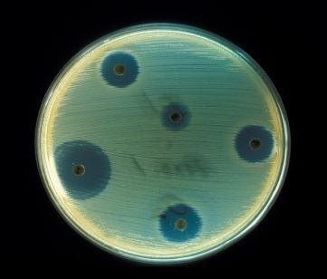
Mutation and Bacterial Change
_________ __________= When a microorganism is able to survive exposure to an antibiotic.
Genetic mutation in bacteria can produce resistance to antimicrobial drugs (example: beta-lactamase).
If those genes are on a plasmid, they can be transferred between bacteria by conjugation and other forms of horizontal gene transfer.
If a bacterium carries several resistance genes, it is called multidrug resistant (MDR) or, informally, a superbug or super bacterium.
Any use of antibiotics can increase selective pressure in a population of bacteria to allow the resistant bacteria to thrive and the susceptible bacteria to die off.
REVIEW!
Antibiotic Resistance Animation
from Sumanas
From the Virtual Biology Classroom on ScienceProfOnline.com
Image: Staphylococcus aureus on antibiotic test plate, PHIL #2641
Notes:
Antibiotic resistance

Slide 16
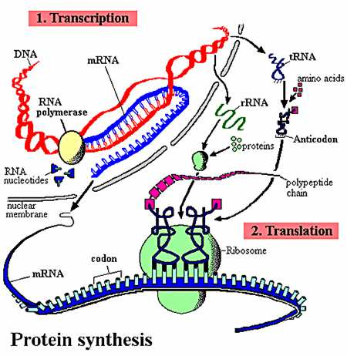
Gene Expression
Transcription
&
Translation
(Making Proteins)
From the Virtual Biology Classroom on ScienceProfOnline.com

Slide 17
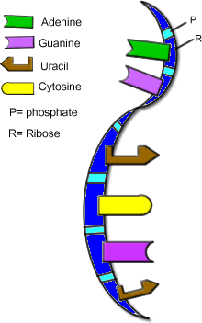
Nucleic Acids: RNA Structure
RNA is typically a single-stranded molecule.
Purine Bases (double ring)
Adenine & Guanine
Pyrimidine Bases (single ring)
Cytosine & _______
From the Virtual Biology Classroom on ScienceProfOnline.com
Image: RNA, Biology Corner
Notes:
Uracil

Slide 18

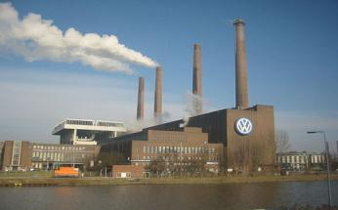
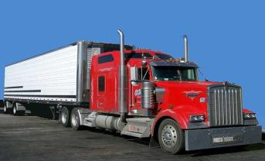
Types of RNA
Genetic information copied from DNA is transferred to 3 types of RNA:
messenger (mRNA) is like a
Copy of information in DNA that is brought to
the ribosome where the information is
translated into a protein.
ribosomal (rRNA) is like a
The protein factories of the cells.
transfer (tRNA) are like a
Brings the amino acid to the ribosome.
Images: Blueprint, clipart; Factory, Andreas Praefcke; Truck, PRA; Ribosome translating protein, Xvazquez.
From the Virtual Biology Classroom on ScienceProfOnline.com
Notes:
blueprint
factory
truck

Slide 19
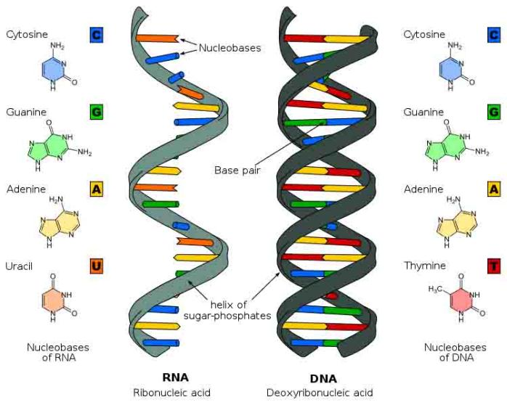
Nucleic Acid Structure
See SPO Class Notes article on Nucleotides & Nucleic Acids.
From the Virtual Biology Classroom on ScienceProfOnline.com
Image: Comparison of DNA & RNA, Wiki Commons
Notes:
Uracil

Slide 20
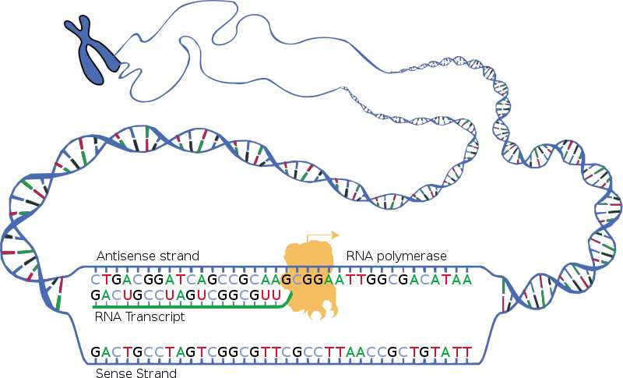
Transcription
First Step of gene expression.
Process by which a DNA sequence is copied to produce a complementary mRNA strand.
In other words, it is the transfer of genetic information from DNA into RNA.
Like replication, but making RNA.
Beginning of the process that ultimately leads to the translation of the genetic code (via mRNA) into a protein.
REVIEW
Transcription Animations
mRNA Synthesis from McGraw-Hill
2. Transcription from WH Freeman
Image: Transcription, National Human Genome Research Institute.
From the Virtual Biology Classroom on ScienceProfOnline.com

Slide 21
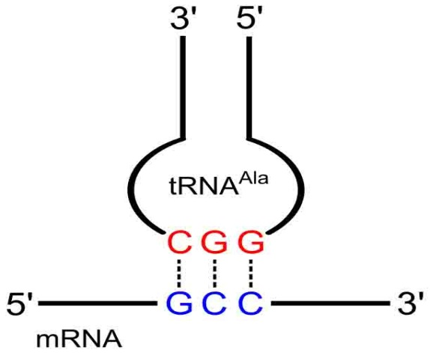
Translation
Second Step of gene expression.
Ribosomes (which contain rRNA) make proteins from the messages encoded in mRNA.
The genetic instructions for a polypeptide chain are ‘written’ in the DNA as a series of
3-nucleotide ‘words.’
______ on mRNA
___________ on tRNA
‘U’ (uracil) replaces ‘T’ in RNA
This is the genetic code.
Anti-codon
Codon
Image: Codon-Anticodon pairing, Yikrazuul, Wiki; Peptide Synthesis Diagram: Boumphreyfr, Wiki.
From the Virtual Biology Classroom on ScienceProfOnline.com
Notes:
Genetic Code
Ribosomes
Codon
Anti-codon

Slide 22
Translation
REVIEW
Translation Animations
How Translation Works from McGraw-Hill
Ribosome Building
a Protein
from Wikipedia
From the Virtual Biology Classroom on ScienceProfOnline.com
Image: Peptide Synthesis Diagram: Boumphreyfr, Wiki

Slide 23
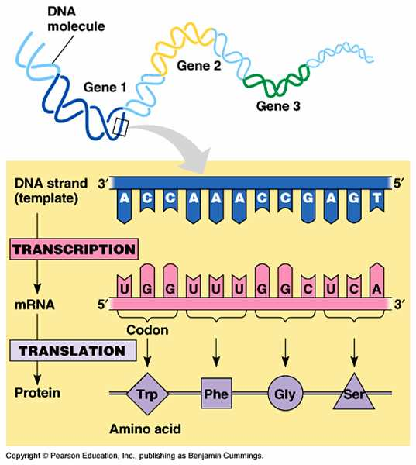
Transcription & Translation Overview
REVIEW
Interactive animation that allows you to transcribe and translate
a gene!
See SPO Class Notes article on DNA Function: Transcription & Translation.
From the Virtual Biology Classroom on ScienceProfOnline.com

Slide 24
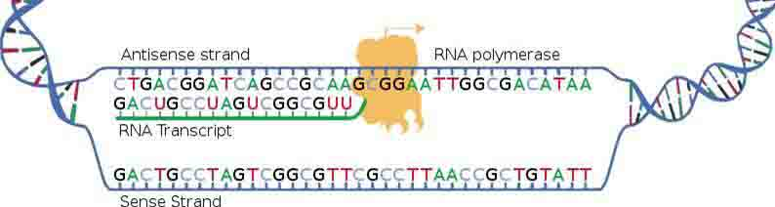
Replication, Transcription, Translation
  MAKING DNA
  Making a copy of the genetic material = Replication
  When you think “replication” think “duplication”
  Q: Where does replication occur in prokaryotes? Eukaryotes?
  MAKING RNA
  Transferring genetic code (DNA) to RNA = Transcription
  Think of a medical transcriptionist copying the physicians words into another format.
  Q: Where does transcription occur in prokaryotes? Eukaryotes?
  MAKING PROTEINS
  Making proteins = Translation
  Think of how translation relates to languages.
  The translation of biology translates DNA information into proteins.
  Q: Where does translation occur in prokaryotes? Eukaryotes?
Images: Replication Diagram: Madprime; Peptide Synthesis Diagram: Boumphreyfr, Wiki
From the Virtual Biology Classroom on ScienceProfOnline.com
Notes:
Translation

Slide 25
Hereditary Diseases are due to DNA mutations
All inherited diseases arise from a mistake in the genetic code passed down from a person’s parents, which leads to a defective protein.
Image: Peptide Synthesis Diagram: Boumphreyfr, Wiki; Replication Diagram: Madprime, Wiki
From the Virtual Biology Classroom on ScienceProfOnline.com

Slide 26
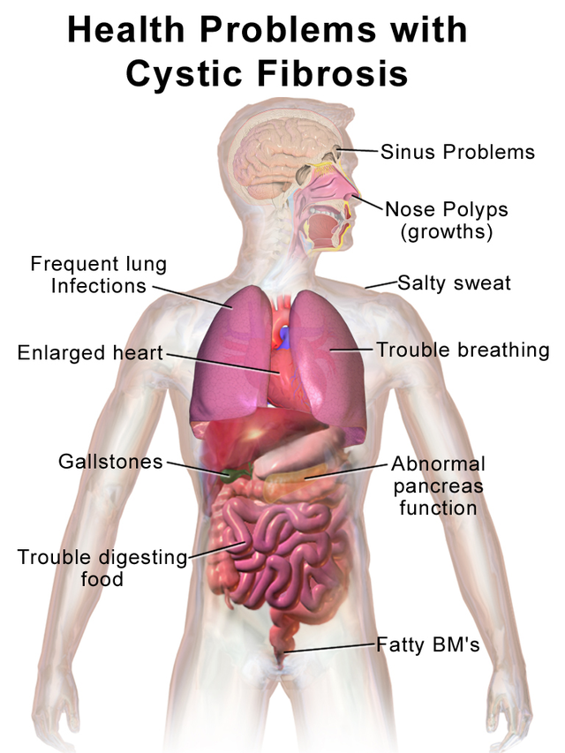
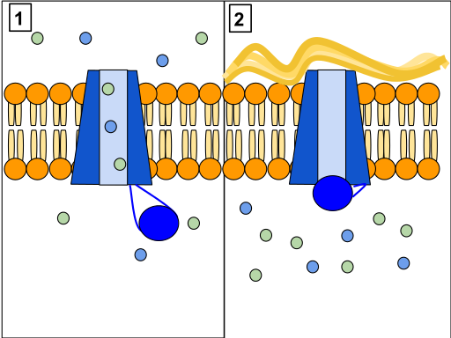
Most common, fatal genetic disease in the US.
Causes body to produce thick mucus that:
- clogs the lungs
- leads to infections
- blocks pancreas from delivering digestive enzymes to intestine.
Results from mutations in a single gene:
Cystic Fibrosis Transmembrane Regulator (CFTR) gene.
In normal cells, the CFTR channel protein allows cells to release chloride and other ions.
In people with CF, this protein is defective. Cells are not able to release chloride, resulting in an improper salt balance in the cells and thick, sticky mucus.
Medical research is focusing on ways to cure CF by correcting the defective gene, or correcting the defective protein.
Genetic Disease: Cystic Fibrosis (CF)
CFTR channel protein controls flow of H₂O and Cl- inside the lungs. When this protein is working correctly (Panel 1) ions can flow in and out of the cells. But, when the CFTR protein is blocked (Panel 2) these ions cannot flow out of the cell.
Images: Health Problems of Cystic Fibrosis, Bruce Blaus Wiki, CFTR, Protein Channel, Wiki
From the Virtual Biology Classroom on ScienceProfOnline.com

Slide 27
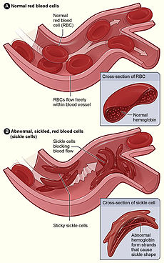
Most common inherited blood disorder in US.
Most prevalent among African Americans (~1 in 500) and Hispanic Americans (~1 in 1,000).
Hemoglobin is the molecule in red blood cells (RBCs) that delivers oxygen from the lungs to the body’s cells.
Caused by a mutation in the hemoglobin-beta gene found on chromosome 11.
People with this disorder have atypical hemoglobin, which can distort red blood cells into a sickle, or crescent, shape.
Sickle shaped RBCs can pile up, rather than flow, causing blockages and damaging vital organs and tissue.
People who only carry one copy of sickle cell gene typically don't get the disease, but can pass that defective gene on to their children.
Children who get this trait from both parents get the disease (recessive trait).
Genetic Disease: Sickle Cell Disease
From the Virtual Biology Classroom on ScienceProfOnline.com
Image: Sickle Cell Diagram. Wiki

Slide 28
Confused?
Here are links to fun resources that further explain genetic transcription & translation:
Molecular Genetics: Replication Main Page on the Virtual Cell Biology Classroom of Science Prof Online.
“That Spells DNA” song by Jonathan Coulton.
DNA Structure Cell Biology Animation from John Kyrk.
Build a DNA Molecule from University of Utah.
DNA Replication animation and review questions.
DNA Replication Process animated video by FreeScienceLectures.com.
DNA Replication step-through animation by John Kyrk.
Transcription & Translation Main Page on the Virtual Cell Biology Classroom of Science Prof Online.
DNA Transcription step-through animation by John Kyrk.
Transcribe & Translate a Gene, from University of Utah.
DNA Transcription and Protein Assembly animated movie by RedAndBrownPaperBag.
Transcription and Translation animated movie from PBS production “DNA: The Secret of Life.
(You must be in PPT slideshow view to click on links.)
Smart Links
From the Virtual Biology Classroom on ScienceProfOnline.com

