Slide 1
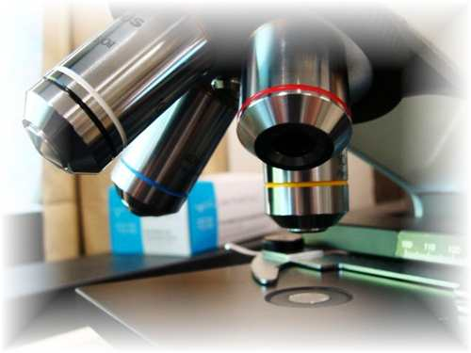
About Science Prof Online
PowerPoint Resources
Science Prof Online (SPO) is a free science education website that provides fully-developed Virtual Science Classrooms, science-related PowerPoints, articles and images. The site is designed to be a helpful resource for students, educators, and anyone interested in learning about science.
The SPO Virtual Classrooms offer many educational resources, including practice test questions, review questions, lecture PowerPoints, video tutorials, sample assignments and course syllabi. New materials are continually being developed, so check back frequently, or follow us on Facebook (Science Prof Online) or Twitter (ScienceProfSPO) for updates.
Many SPO PowerPoints are available in a variety of formats, such as fully editable PowerPoint files, as well as uneditable versions in smaller file sizes, such as PowerPoint Shows and Portable Document Format (.pdf), for ease of printing.
Images used on this resource, and on the SPO website are, wherever possible, credited and linked to their source. Any words underlined and appearing in blue are links that can be clicked on for more information. PowerPoints must be viewed in slide show mode to use the hyperlinks directly.
Several helpful links to fun and interactive learning tools are included throughout the PPT and on the Smart Links slide, near the end of each presentation. You must be in slide show mode to utilize hyperlinks and animations.
This digital resource is licensed under Creative Commons Attribution-ShareAlike 3.0:
http://creativecommons.org/licenses/by-sa/3.0/
Alicia Cepaitis, MS
Chief Creative Nerd
Science Prof Online
Online Education Resources, LLC
alicia@scienceprofonline.com
Tami Port, MS
Creator of Science Prof Online
Chief Executive Nerd
Science Prof Online
Online Education Resources, LLC
info@scienceprofonline.com
From the Virtual Biology Classroom on ScienceProfOnline.com
Image: Compound microscope objectives, T. Port
Notes:
Welcome to Science Prof Online PowerPoint Resources!
This PowerPoint Presentation comes from the Virtual Cell Biology Classroom of Science Prof Online, and, as such, is licensed under Creative Commons Attribution-ShareAlike 3.0.; meaning you can download, share and alter any of this presentation, but you can’t sell it or repackage and sell any part of it. Please credit Science Prof Online as the source of this presentation. Please abide by credited image copyrights. Thank you for using this resource.

Slide 2
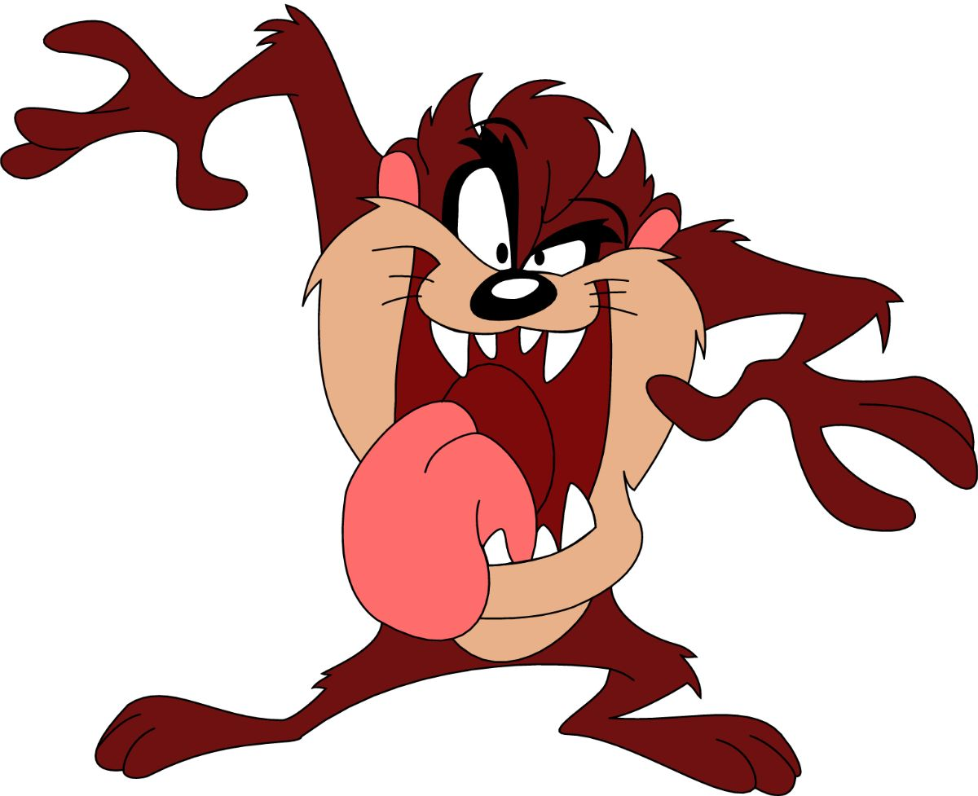
Tasmanian Devils
VIDEO:
Tasmanian Devil “What’s Up Doc?” Loony Toons clip.
From the Virtual Biology Classroom on ScienceProfOnline.com

Slide 3
Tasmanian Devils
From the Virtual Biology Classroom on ScienceProfOnline.com

Slide 4
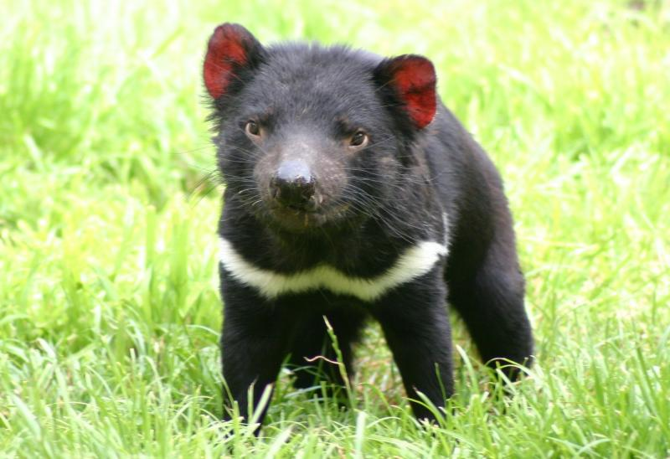
Tasmanian Devils are REAL!
From the Virtual Biology Classroom on ScienceProfOnline.com

Slide 5
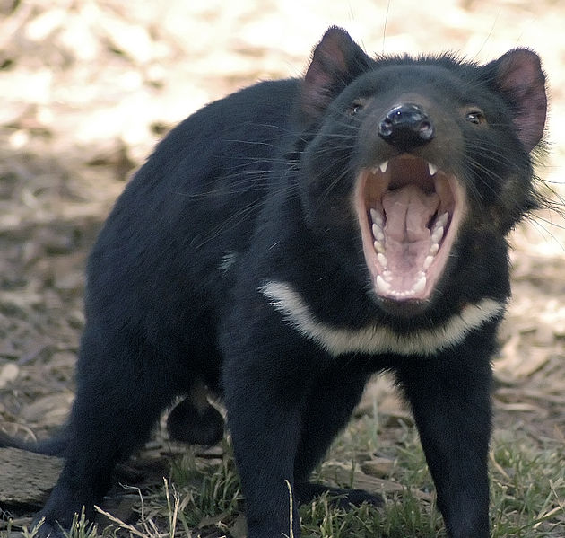
Tasmanian Devils are FIERCE!
VIDEO:
Tasmanian Devils
Battle
from
Animal
Planet
From the Virtual Biology Classroom on ScienceProfOnline.com
Image: Tasmanian Devil, Wiki

Slide 6
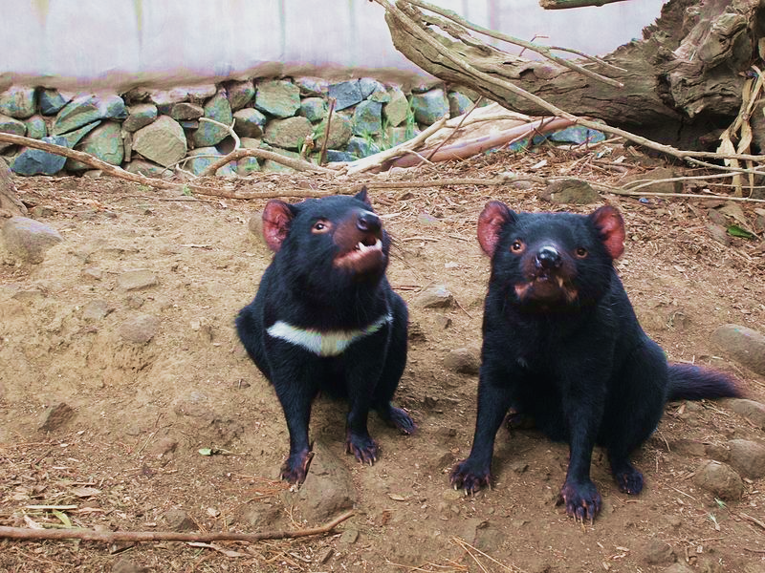
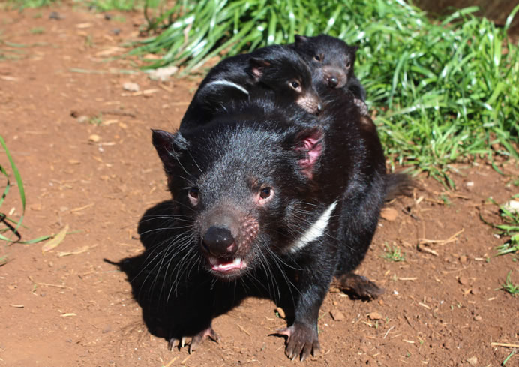
More About Tasmanian Devils
Mammals
Marsupials
Carnivore
(hunter & scavenger)
Size of a small dog
Muscular
Strongest bite per body mass
Loud
Ferocious
Stinky (when stressed)
Excellent sense of smell
Often feed in groups
Dominance (most aggressive > least aggressive)
Fight for food and mates
Baby Tasmanian devils are called “imps”, “pups or “joeys””.
From the Virtual Biology Classroom on ScienceProfOnline.com
Images: Pair of Tasmanian Devils; Tasmanian Devil, Wiki

Slide 7
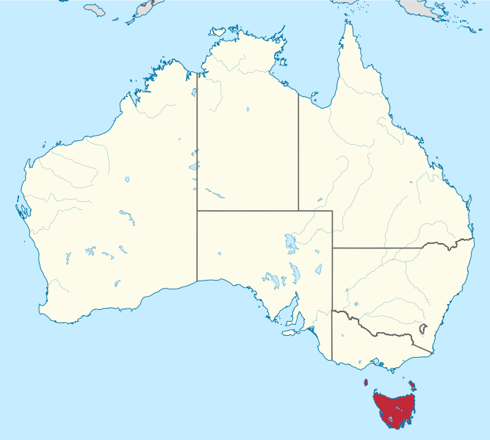
Where the heck is Tasmania?
You are here.
Island state of Australia.
26th largest island in world
Climate similar, but not as cold, as ours.
Four seasons.
Summer lasts from December to February.
35,042 square miles.
Population 515,000.
Michigan LP is 56,809 square miles.
Michigan LP population almost 10 million.
It would take more than 24 hours to take an airplane there!
Tasmania
are here.
From the Virtual Biology Classroom on ScienceProfOnline.com
Image: World Map, Australia & Tasmania, Wiki

Slide 8
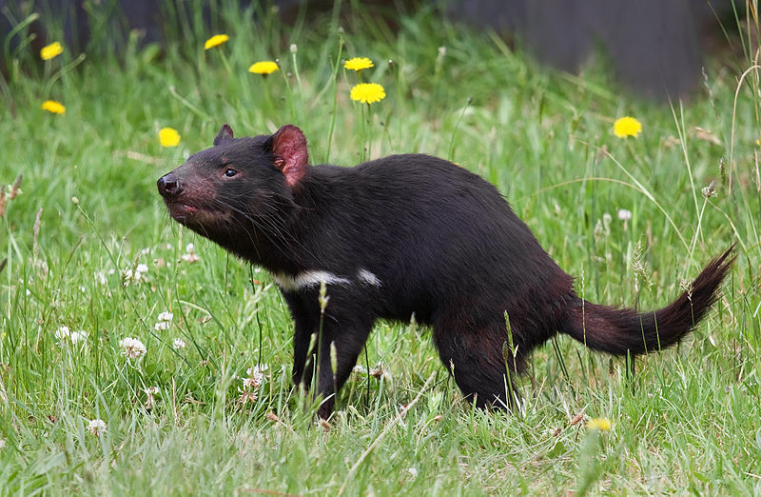
Lets watch more videos of Tasmanian Devils!
Tasmanian Devil, from Science Channel
Taz Devil Talking to Me (followed by Angry Devil), from Snake Artist
Baby Tasmanian Devils in Kitchen, from Snake Artist
From the Virtual Biology Classroom on ScienceProfOnline.com
Image: Tasmanian Devil, Wiki
Image: Tasmanian Devil, Wiki

Slide 9
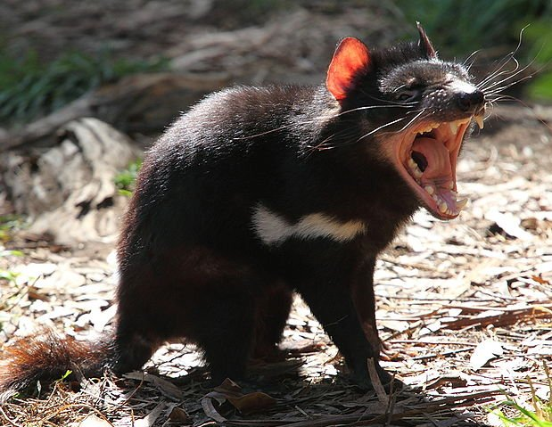
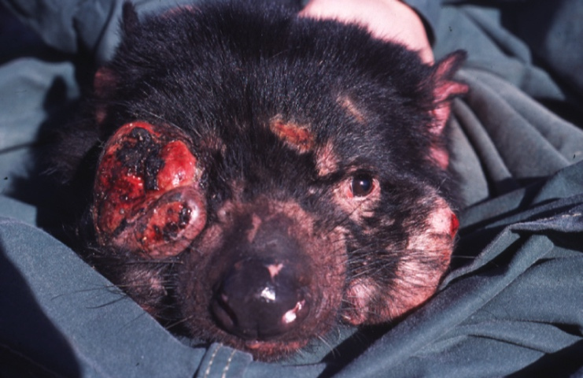
Why Would An Animal this Fierce Need Our Help?
Tasmanian Devil Facial Tumor Disease
From the Virtual Biology Classroom on ScienceProfOnline.com
Image: Tasmanian Devil with facial tumors, Wiki

Slide 10
Devil Facial Tumor Disease
(DFTD)
DFTD is an aggressive (fast growing), parasitic cancer found only in Tasmanian Devils.
DFTD is very unusual, one of only four known cancers that can spread like a contagious disease (disease you can catch).
From the Virtual Biology Classroom on ScienceProfOnline.com
Image: Tasmanian Devil with facial tumors, Wiki

Slide 11
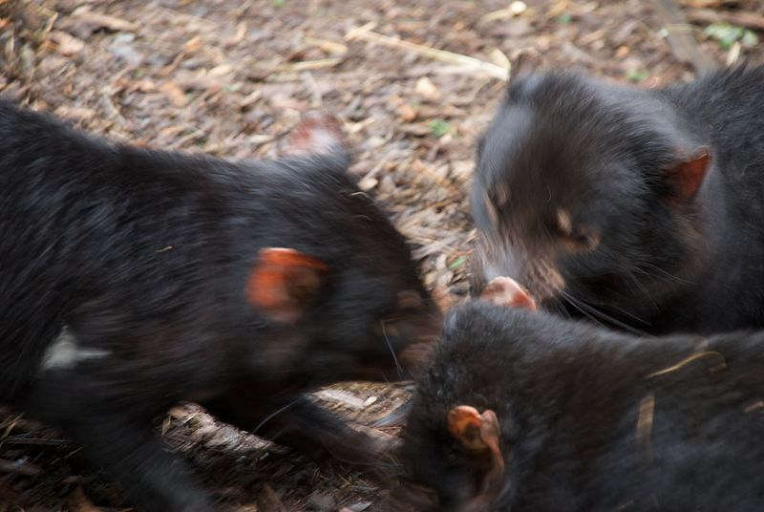
Devil Facial Tumor Disease
(DFTD)
The cancer is passed from devil to devil through biting.
Devils bite each other in the face a lot, when feeding and fighting with their mates.
The tumor is crumbly, and pieces break off easily. When tumor pieces fall into bite wounds, new tumors form and grow.
Tumors usually first appear in and around the mouth, and look like small sores or lumps. Then develop into large tumors around the face and neck.
From the Virtual Biology Classroom on ScienceProfOnline.com
Image: Tasmanian Devils feeding, Wiki

Slide 12
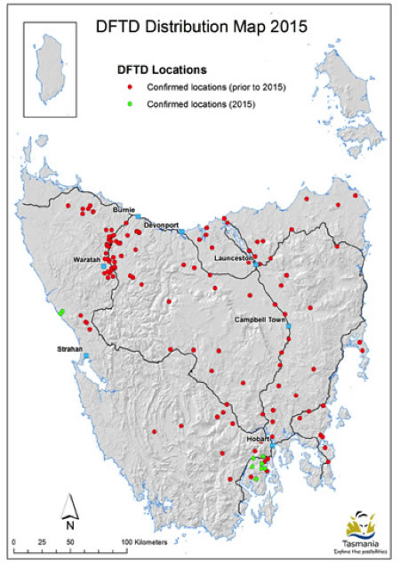
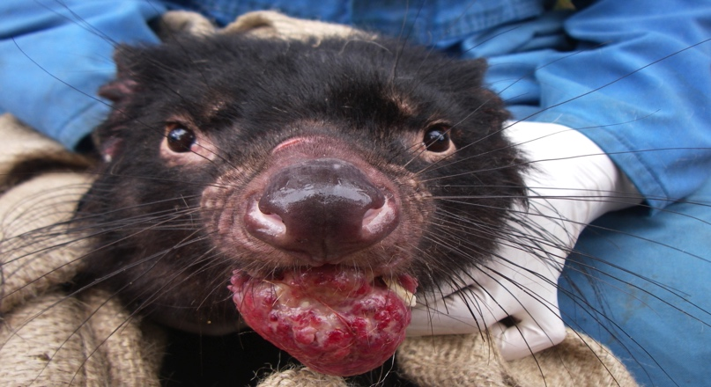
Devil Facial Tumor Disease
(DFTD)
Since the late 1990s, Devil Facial Tumor Disease has reduced the Tasmanian Devil population so much that these animals might go extinct.
In 2008, the Tasmanian Devil was declared an endangered species.
Images: from the Devil Ark website. Donate and help save the Tasmanian Devil!
From the Virtual Biology Classroom on ScienceProfOnline.com

Slide 13
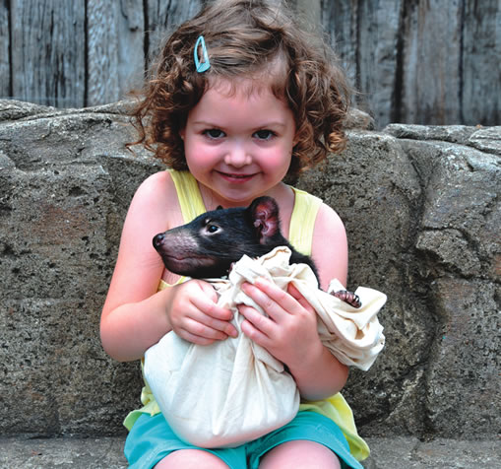
Devil Facial Tumor Disease
(DFTD)
The tumors make it hard for devils to find and eat food.
Once the tumor is big enough to be seen, it is always fatal.
But we can help!
Here’s how…
Images: Tasmanian Devil with facial tumors, Wiki; Devil Ark photo of girl holding Tasmanian devil
From the Virtual Biology Classroom on ScienceProfOnline.com

Slide 14
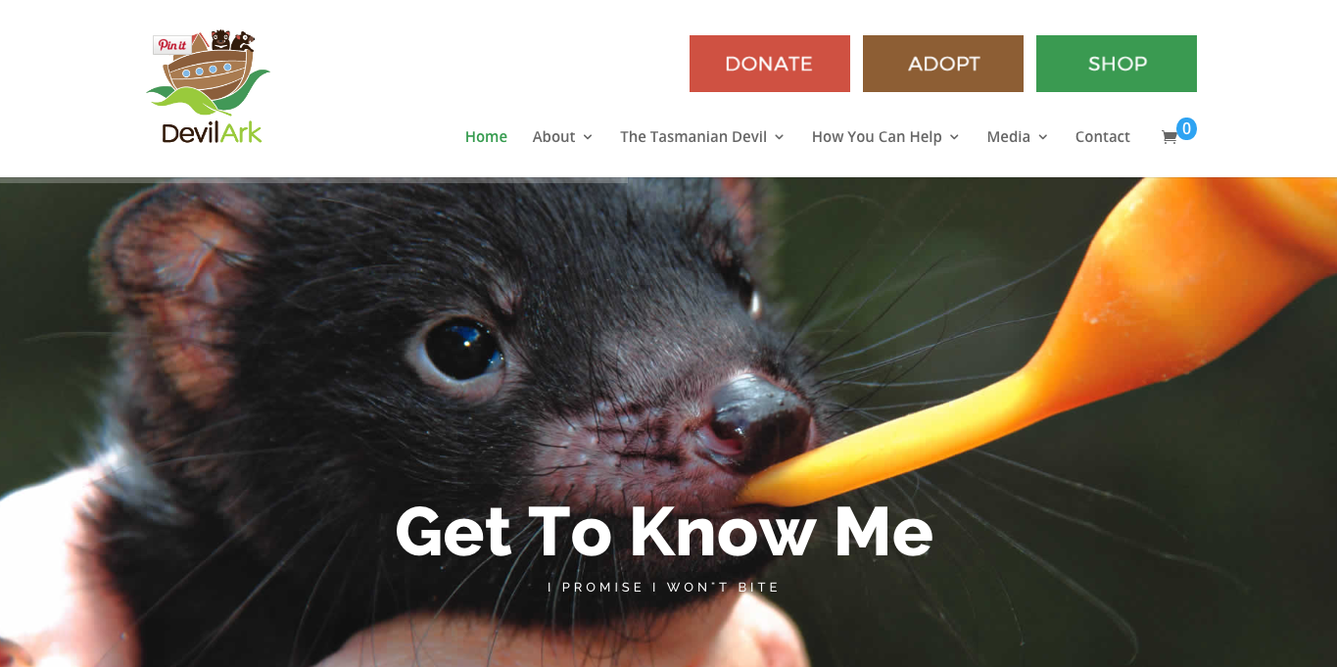
Adopt a Tasmanian Devil
through Australia’s
Devil Ark conservation program!

Slide 15
Luv Tasmanian Devils!
From the Virtual Biology Classroom on ScienceProfOnline.com
Image: Mother Tasmanian Devil at Devil Ark.

