Slide 1
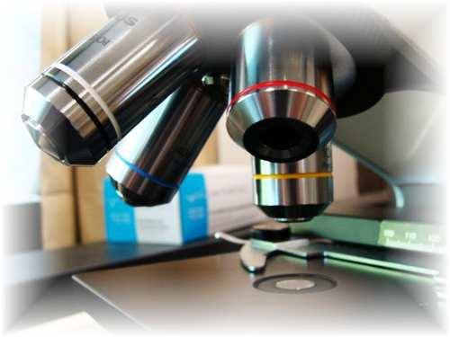
About Science Prof Online
PowerPoint Resources
Science Prof Online (SPO) is a free science education website that provides fully-developed Virtual Science Classrooms, science-related PowerPoints, articles and images. The site is designed to be a helpful resource for students, educators, and anyone interested in learning about science.
The SPO Virtual Classrooms offer many educational resources, including practice test questions, review questions, lecture PowerPoints, video tutorials, sample assignments and course syllabi. New materials are continually being developed, so check back frequently, or follow us on Facebook (Science Prof Online) or Twitter (ScienceProfSPO) for updates.
Many SPO PowerPoints are available in a variety of formats, such as fully editable PowerPoint files, as well as uneditable versions in smaller file sizes, such as PowerPoint Shows and Portable Document Format (.pdf), for ease of printing.
Images used on this resource, and on the SPO website are, wherever possible, credited and linked to their source. Any words underlined and appearing in blue are links that can be clicked on for more information. PowerPoints must be viewed in slide show mode to use the hyperlinks directly.
Several helpful links to fun and interactive learning tools are included throughout the PPT and on the Smart Links slide, near the end of each presentation. You must be in slide show mode to utilize hyperlinks and animations.
This digital resource is licensed under Creative Commons Attribution-ShareAlike 3.0:
http://creativecommons.org/licenses/by-sa/3.0/
Alicia Cepaitis, MS
Chief Creative Nerd
Science Prof Online
Online Education Resources, LLC
alicia@scienceprofonline.com
Tami Port, MS
Creator of Science Prof Online
Chief Executive Nerd
Science Prof Online
Online Education Resources, LLC
info@scienceprofonline.com
From the Virtual Biology Classroom on ScienceProfOnline.com
Image: Compound microscope objectives, T. Port
Notes:
Welcome to Science Prof Online PowerPoint Resources!
This PowerPoint Presentation comes from the Virtual Cell Biology Classroom of Science Prof Online, and, as such, is licensed under Creative Commons Attribution-ShareAlike 3.0.; meaning you can download, share and alter any of this presentation, but you can’t sell it or repackage and sell any part of it. Please credit Science Prof Online as the source of this presentation. Please abide by credited image copyrights. Thank you for using this resource.

Slide 2
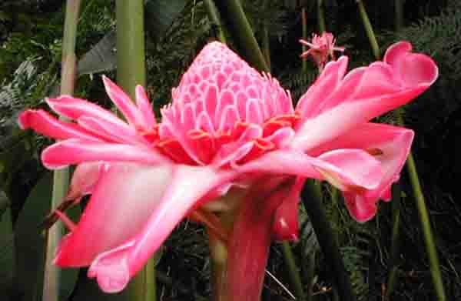
Introduction
to
Biology
VIDEO: Introduction to Biology
From the Virtual Biology Classroom on ScienceProfOnline.com
Image: Hawaiian Ginger, T. Port

Slide 3
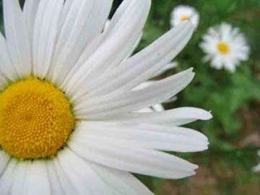
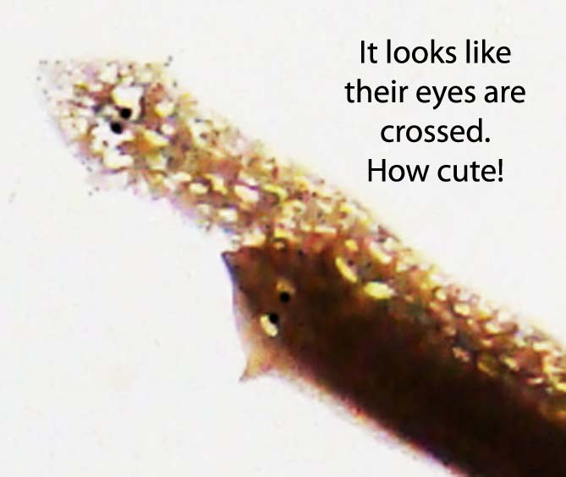
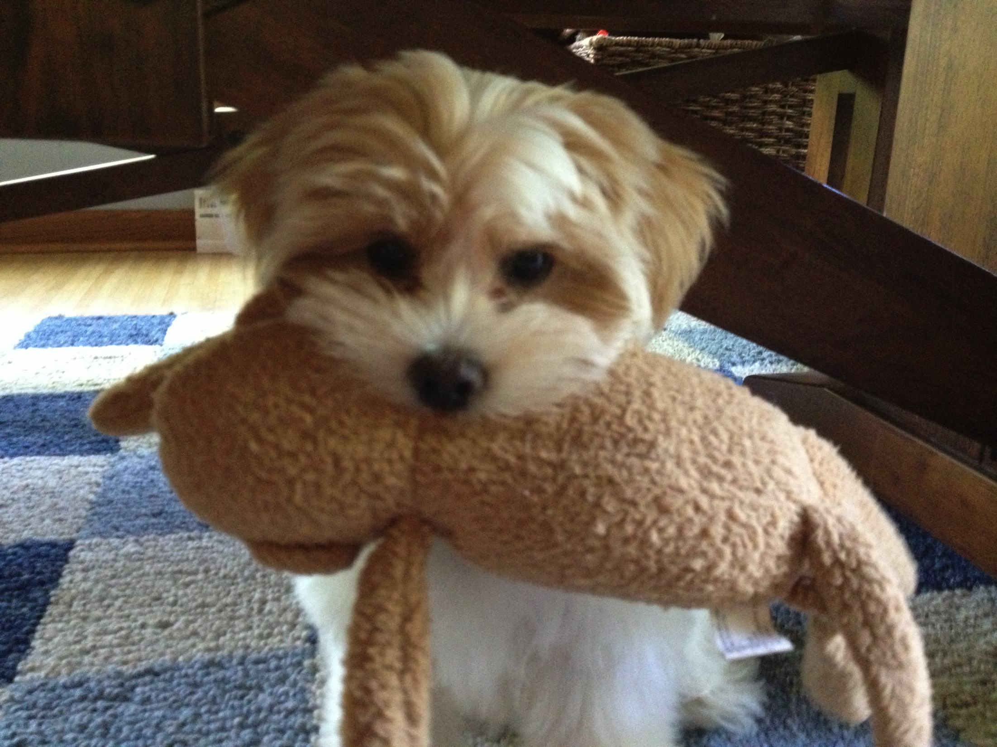
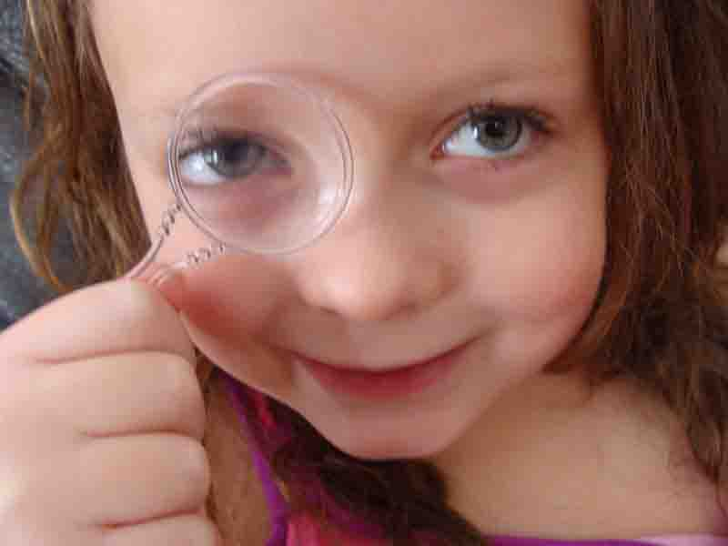
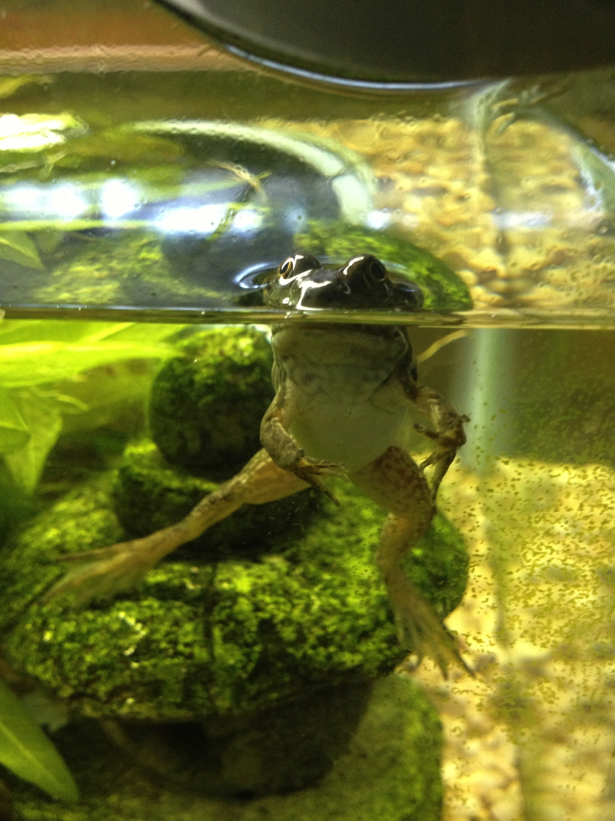
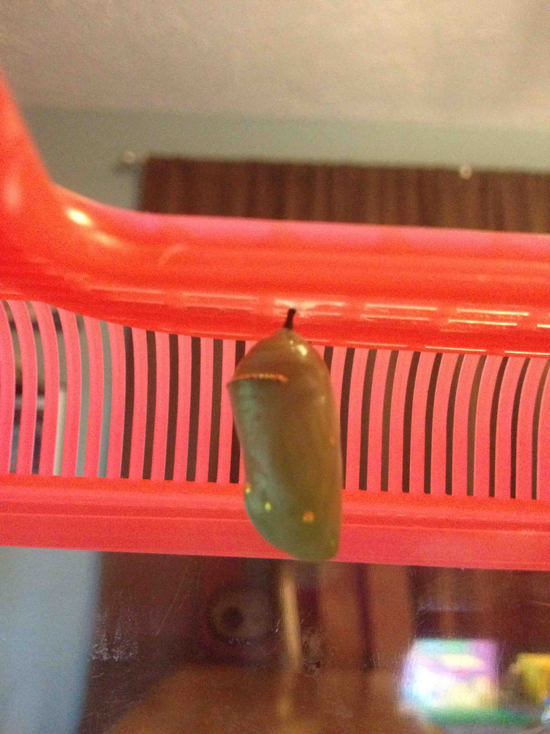
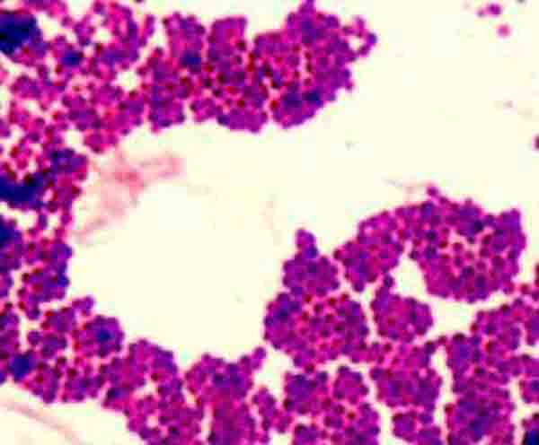
What is biology?
The study of LIVING THINGS
From the Virtual Biology Classroom on ScienceProfOnline.com
All photos by T. Port
Notes:
Tool

Slide 4
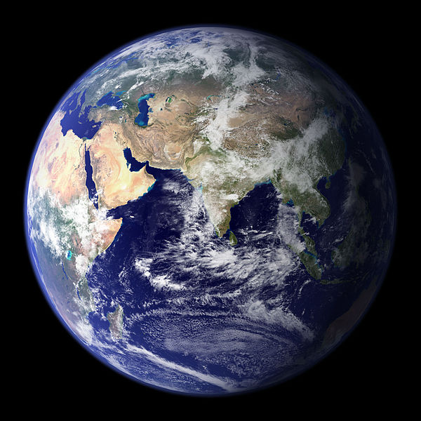
Where can living things be found?
From the Virtual Biology Classroom on ScienceProfOnline.com
Image: Earth, Wiki

Slide 5
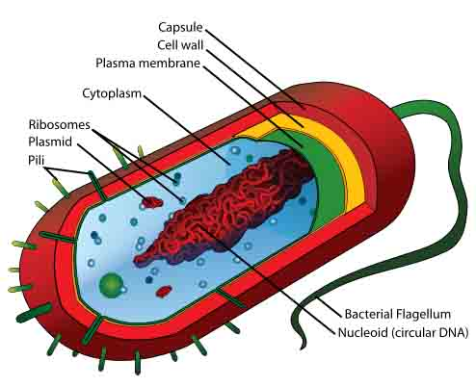
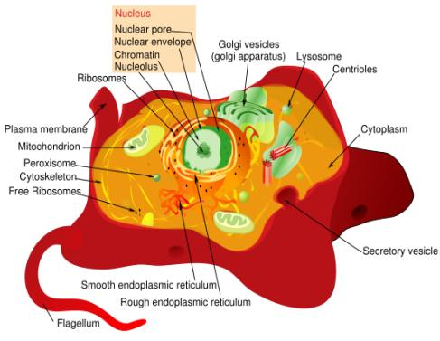
CELLS Are the Building Blocks of Life!
Prokaryotic Cell
Eukaryotic Cell
All living things are made of one or more cells.
Cells only come from other cells.
Cells are really small.
How small are they?
Images: Prokaryotic cell diagram & Eukaryotic cell diagram, M. Ruiz
From the Virtual Biology Classroom on ScienceProfOnline.com

Slide 6
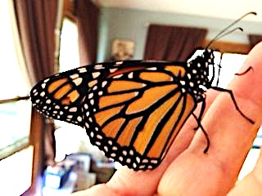
How do you define living?
Some characteristics of life …
Organization
Acquire and transform materials & energy
Homeostasis
Respond to stimuli
Grow, develop & reproduce
Adapt and evolve
(change)
Image: Newly emerged Monarch Butterfly, T. Port
From the Virtual Biology Classroom on ScienceProfOnline.com

Slide 7
Cellular Organisms vs Acellular Particles
Eukaryotic Cell
1. Cellular life:
Prokaryotes
Example: Bacteria
Eukaryotes
Example: Most other
cellular life.
2. Acellular infectious particles:
Viruses
Virus
Prokaryotic Cell
Eukaryotic Nucleus
1 ųm (1000 nm)
From the Virtual Biology Classroom on ScienceProfOnline.com

Slide 8
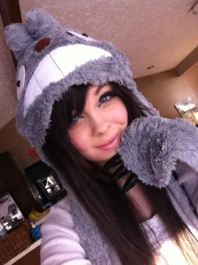
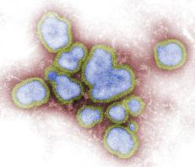
Are Viruses Alive?
Viruses
  are not made of cells
  cannot reproduce on their own
  do not grow or undergo division
  do not transform energy (metabolism)
  lack machinery for protein synthesis
Multicellular Organism:
Kayla
Acellular Infectious Agent:
H1N1 Influenza Virus
Later this semester we will examine this question in more detail, through the fantastic Radiolab podcast episode “Shrink.”
Images: Eukaryotic living organism named Kayla, T. Port; H1N1 Influenza Virus, Public Health Image Library (PHIL) #11702
From the Virtual Microbiology Classroom on ScienceProfOnline.com

Slide 9
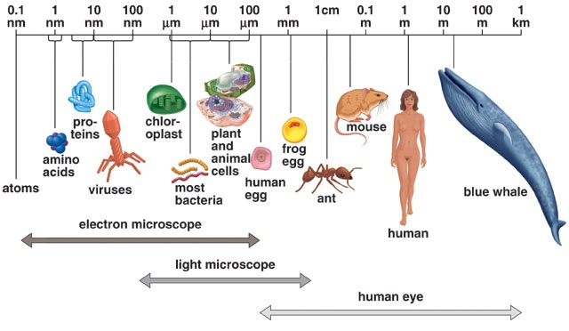
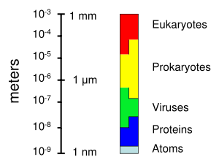
Sizing Things Up (and Down)
1 m = 100 cm = 1,000mm = 1,000,000 µm = 1,000,000,000nm
1mm = 1000 µm = 1000000nm
1 µm = 1000nm
Click link for an interactive
“Size of Microscopic Things”
animation on Cells Alive.
From the Virtual Biology Classroom on ScienceProfOnline.com

Slide 10
Prokaryotes…The “studio apartment” of cells.
From the Virtual Biology Classroom on ScienceProfOnline.com
Image: Prokaryotic cell diagram, M. Ruiz,
Notes:
Prokaryotes …
Reproduce by means of binary fission.
Do not have a cell nucleus or any other organelles with membranes. Plasma membrane their only membrane.
DNA travels openly around the cell.
All bacteria are prokaryotes.

Slide 11
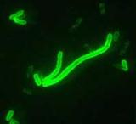
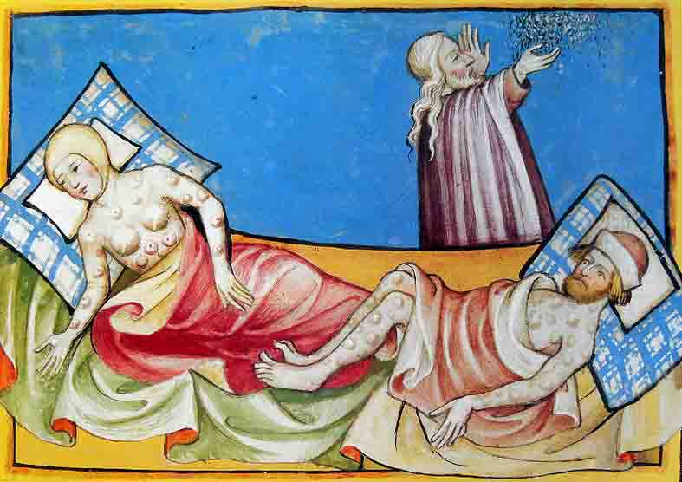
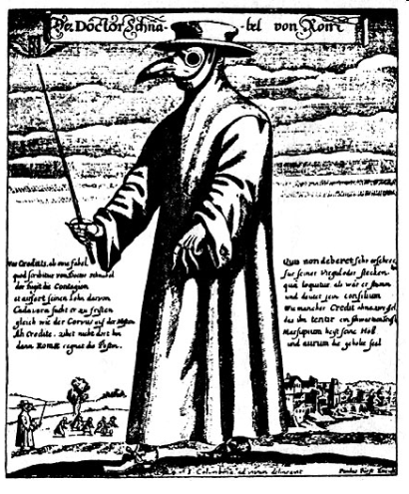
Prokaryotes can be our foes…
Bubonic Plague
a.k.a. Black Plague & Black Death
Caused by bacteria Yersenia pestis.
Several pandemics of plague have occurred throughout history.
50 million deaths between years 1346 – 50.
Nearly 1/2 of Europe perished in this plague
WATCH THIS !”Bring out your dead!” plague scene from Monty Python & Holy Grail.
Doctor beak from Roman engraving, 1656 Physician attire for protection from the Bubonic plague (a.k.a Black death).
Images: Yersenia pestis, CDC; Black Death illustration, Toggenburg Bible (1411); Black Plague Physician Attire, History of Medicine, Paul Furst
From the Virtual Biology Classroom on ScienceProfOnline.com

Slide 12
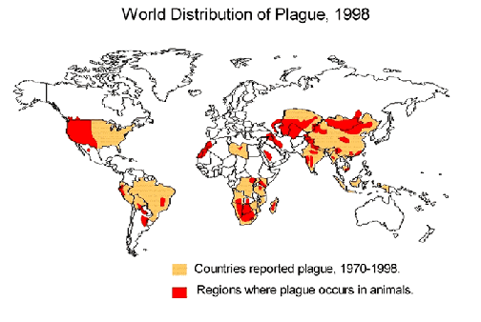
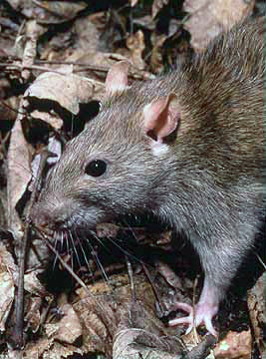
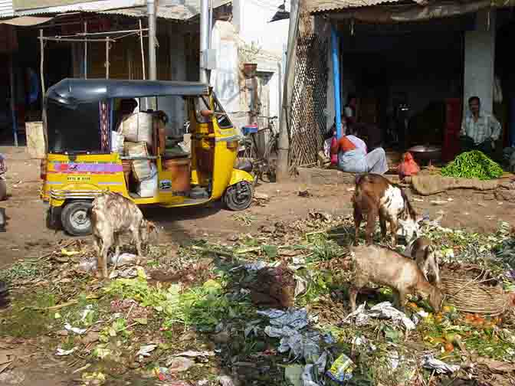
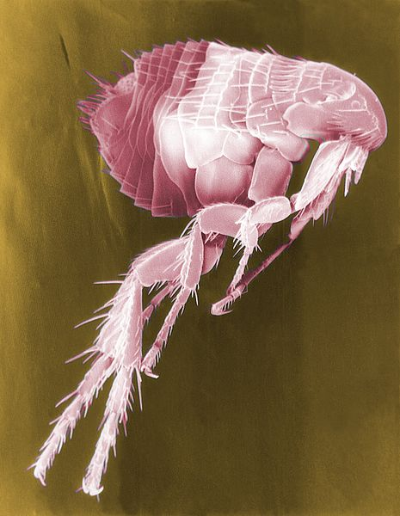
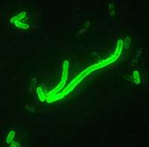
Ecology of
Yersenia pestis
Bubonic Plague
Images: Worldwide distribution of plague 1998, CDC; Waste in open market, frabood; Brown rat, National Park Service; Scanning electron micrograph of flea, CDC; Yersenia pestis, CDC
From the Virtual Biology Classroom on ScienceProfOnline.com

Slide 13

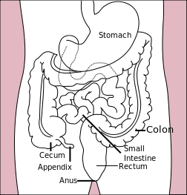
Prokaryotes can be our friends…
Gut Flora
Human body has ~ 100 trillion microbes in intestines (10x more than the total number of human cells in the body).
Bacteria that live on and in us without usually causing harm are called
normal flora.
Bacteria = ~ 60% of the dry mass of poo.
Relationship between gut flora and humans mutualistic … win/win.
Gut microbes perform many useful functions:
  preventing growth of harmful, pathogenic bacteria
  producing vitamins for host (such as biotin and vitamin K)
  producing hormones to direct host to store fats
  keeping our immune system on its toes
Images: E. coli, Rocky Mountain Laboratories, NIAID, NIH; Human Gastrointestinal Tract, Wiki
From the Virtual Biology Classroom on ScienceProfOnline.com

Slide 14
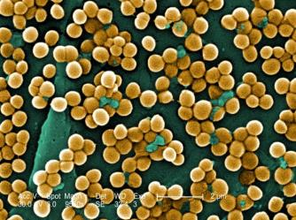

Bacterial “cousins”… one friend, one foe…
Prokaryotes
Staphylococcus
Coccus-shaped bacteria, which divides in a way that results in grape-like clusters.
  Staphylococcus aureus (golden staph), most common cause of staph infections.
  Approximately 20–30% of general population “Staph carriers."
  S. aureus can cause illnesses ranging from minor skin infections to life-threatening diseases, such as meningitis, toxic shock syndrome (TSS) & septicemia.
  MRSA = Methicillin-resistant Staphylococcus aureus
  One of the four most common causes of nosocomial infections, often causing postsurgical wound infections.
  S. epidermidis is normal flora which inhabits the skin of healthy humans.
Staphylococcus aureus,
Golden staph
(One of the reasons
snot gets yellow when
you are sick.)
Our buddy Stapylococcus epidermidis.
Image: Mannitol salt plates, T. Port; S. aureus, Janice Haney Carr , PHIL #10046; Gram stain Staph, T. Port
From the Virtual Biology Classroom on ScienceProfOnline.com

Slide 15
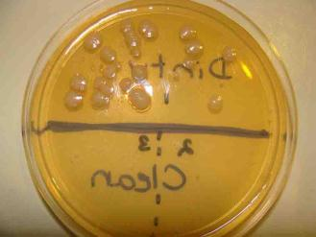
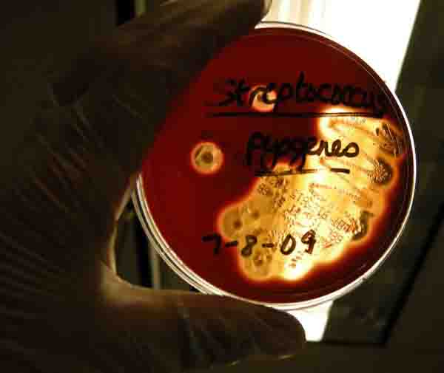
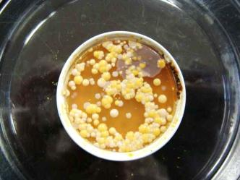
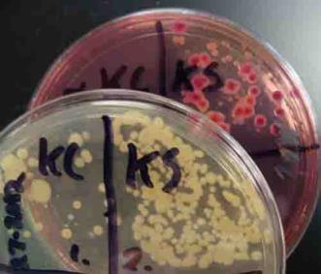
Prokaryotes
Bacteria are
EVERYWHERE!
Images: Various types of bacterial growth media inoculated with different types of samples, T. Port
From the Virtual Biology Classroom on ScienceProfOnline.com
Notes:
Prokaryotes …
Reproduce by means of binary fission.
Do not have a cell nucleus or any other organelles with membranes. Plasma membrane their only membrane.
DNA travels openly around the cell.
All bacteria are prokaryotes.

Slide 16
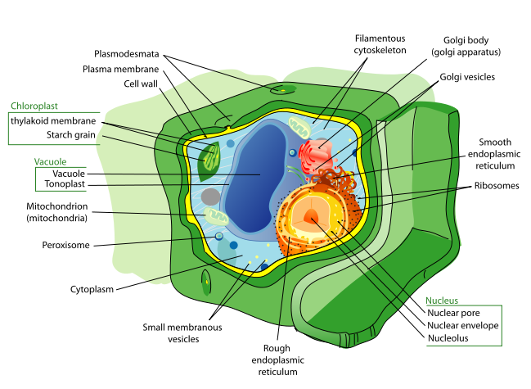

Eukaryotes…The “mansion” of cells.
Images: Animal cell & Plant cell, M. Ruiz
From the Virtual Biology Classroom on ScienceProfOnline.com

Slide 17
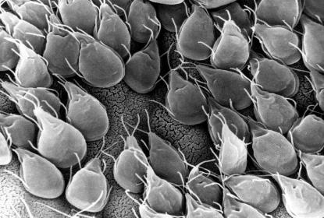
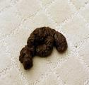
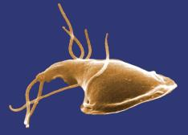
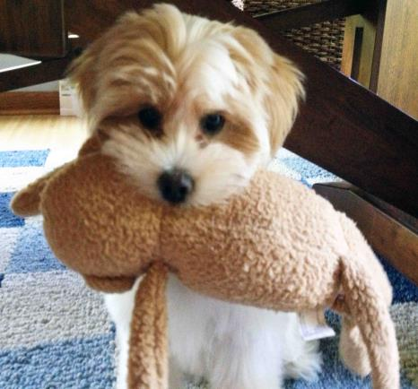
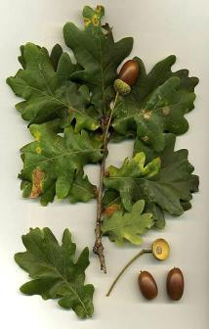
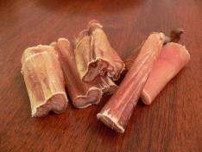
Eukaryotes… are also everywhere.
(Some are macroscopic. Some are microscopic.)
Lulu’s poo was examined for parasites, and they found the single-celled eukaryotic microbe, Giardia.
Her favorite treat is a bully stick, made from bull penises.
Her sock monkey is cotton, a plant product..
She likes to eat acorns, when playing outside.
Lulu, the puppy, is a multicellular eukaryotic organism.
Images: Giardia, Public Health Image Library, (PHIL) #11649; #11632 & #3394; Dog poo & Lulu with sock monkey, T. Port; Oak leaves and acorns, Wiki, Pizzle sticks, Wiki.
From the Virtual Biology Classroom on ScienceProfOnline.com

Slide 18
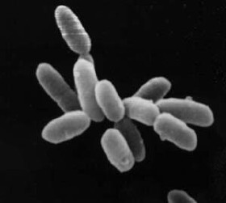
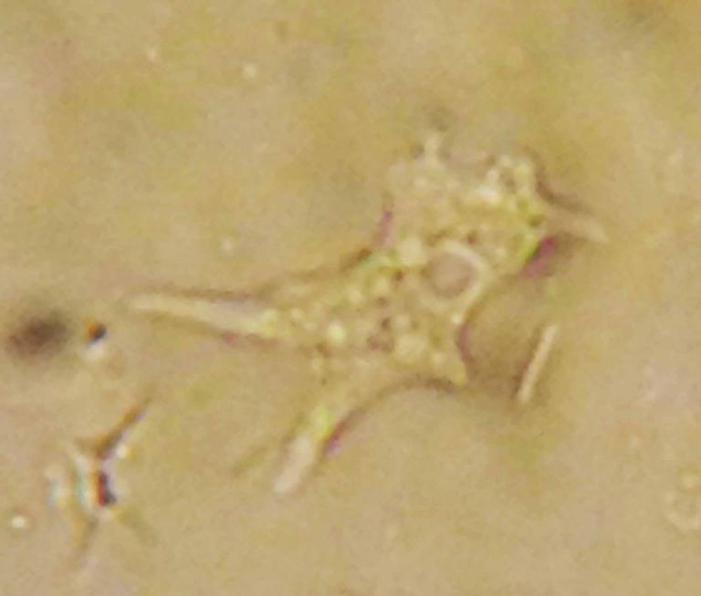
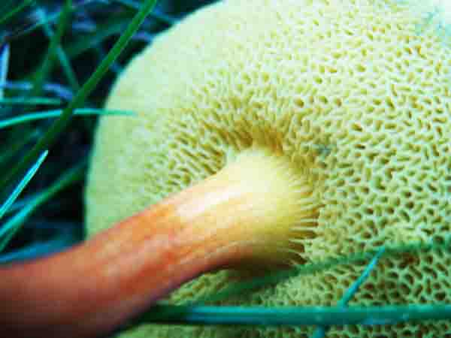
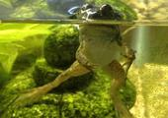
The Major Classifications of
Living Things
Bacteria
Archaea
Protozoa
Plants
Fungi
Animals
Image: S. aureus, Janice Haney Carr , PHIL #10046; Archaea, Wiki; Amoebae, Hawaiian Ginger, Mushroom and Bullfrog by T. Port
From the Virtual Biology Classroom on ScienceProfOnline.com

Slide 19
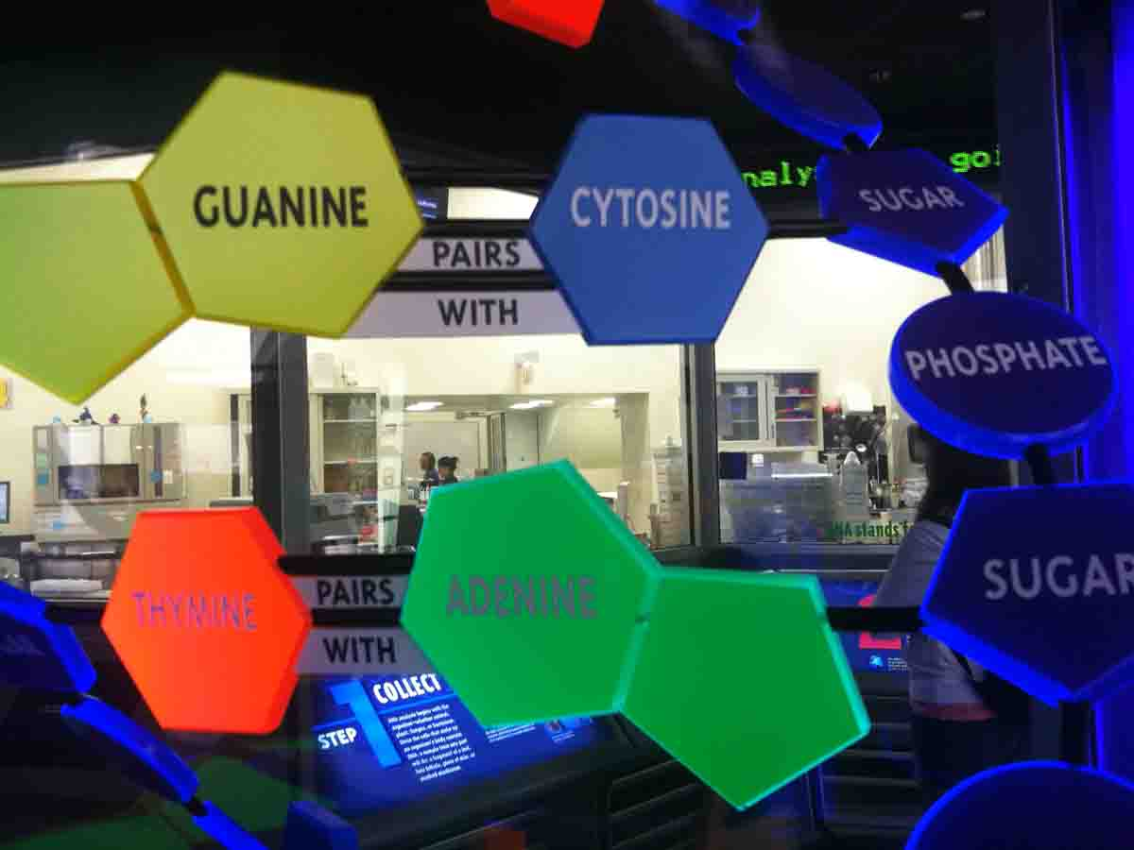
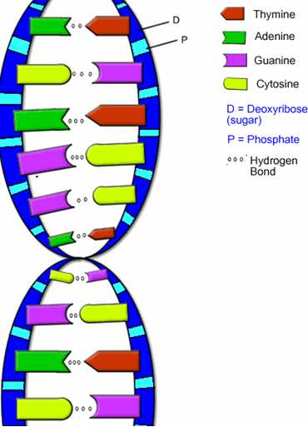
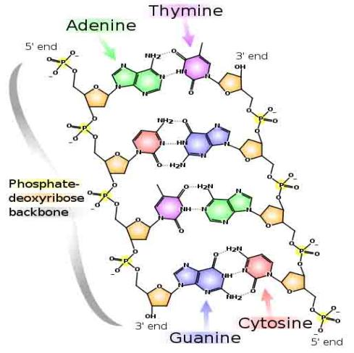
All biological cells have their instruction manual written in DNA (deoxyribonucleic acid).
Images: Model of DNA Molecule, Field Museum, Chicago, T. Port; DNA Detail Diagram: Madprime; DNA & RNA Diagrams, BiologyCorner
From the Virtual Microbiology Classroom on ScienceProfOnline.com

Slide 20
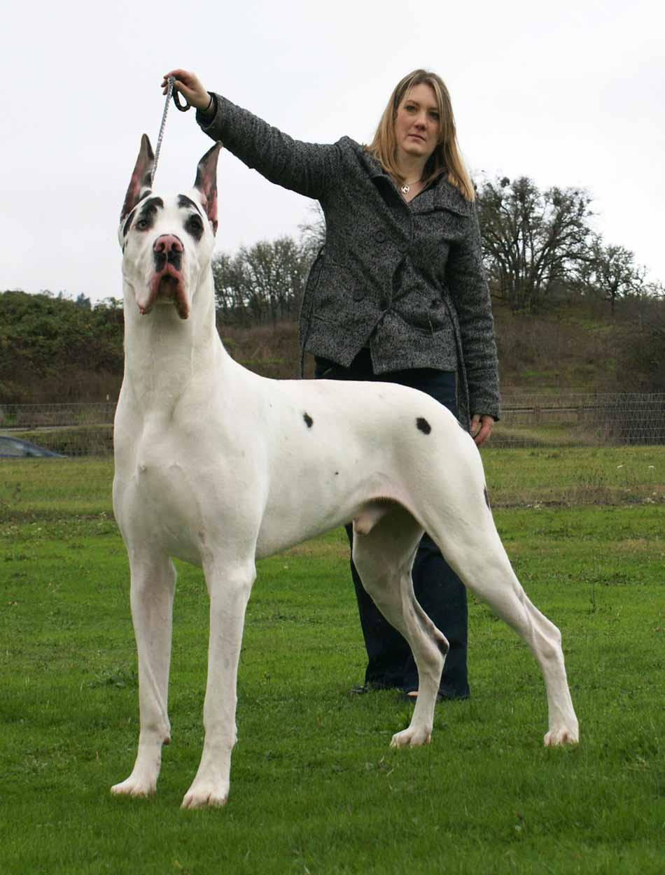
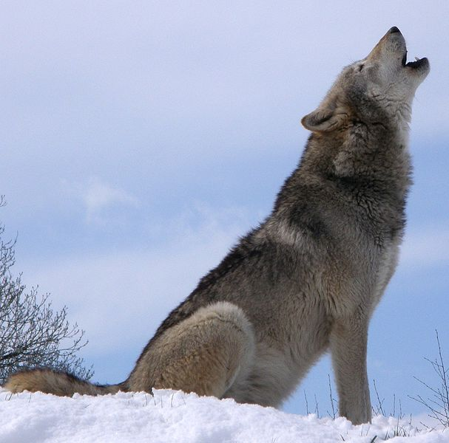
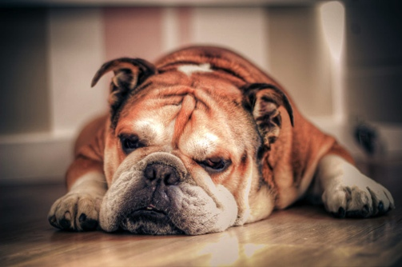
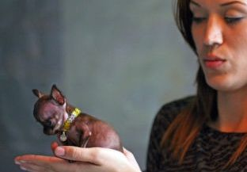
Organisms, Cells & Viruses
Evolve and Change
Naturally and Artificially
Canis lupus familiaris – Domestic dog
Canis lupus - Gray Wolf
Images: Gray wolf, Wiki; Great Dane; English Bulldog, Milly, the worlds smallest Chihuahua
From the Virtual Biology Classroom on ScienceProfOnline.com

Slide 21
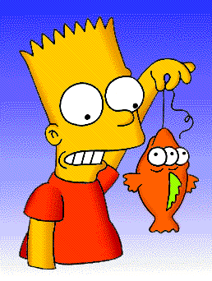

How Does Change Happen?
Mutations of Genes
A mutation is a change (mistake) in the DNA sequence; rare.
Almost always bad news, but...
Rarely leads to a protein having a novel property that improves ability of organism and its descendants to survive and reproduce.
From the Virtual Microbiology Classroom on ScienceProfOnline.com
Images: Blinky & Bart, Matt Groening

Slide 22

Mutations and
Bacterial Change
Antibiotic Resistance = When a microorganism is able to survive exposure to an antibiotic.
Genetic mutation in bacteria can produce resistance to antimicrobial drugs (example: beta-lactamase).
If a bacterium carries several resistance genes, it is called multidrug resistant (MDR) or, informally, a superbug or super bacterium.
Any use of antibiotics can increase selective pressure in a population of bacteria to allow the resistant bacteria to thrive and the susceptible bacteria to die off.
REVIEW!
Antibiotic Resistance Animation
from Sumanas
From the Virtual Cell Biology Classroom on ScienceProfOnline.com
Image: Staphylococcus aureus on antibiotic test plate, PHIL #2641
Notes:
Antibiotic resistance

Slide 23


Why should we care about biology?
Human health care and treatment of diseases, such as plague & smallpox
Care and treatment of our natural resources and other organisms on earth
(Smallpox is a deadly viral disease that was ERADICATED through widespread vaccination. We will talk about smallpox during our next class meeting when we discuss scientific method)
Images: Child with Smallpox, James Hicks, CDC; Monarch Butterfly laying eggs on Common Milkweed.
From the Virtual Biology Classroom on ScienceProfOnline.com

Slide 24
Some Areas of
Biological Study
Botany: Study of plants
Zoology: Study of animals
Anatomy: Structures of organisms
Physiology: Functions within organisms
Ecology: Study of how organism in an ecosystem interact with each other and their environment.
Microbiology: Study of organisms too small to see with the naked eye
From the Virtual Biology Classroom on ScienceProfOnline.com

Slide 25
Confused?
Here are some links to fun resources that can help introduce you to biology:
“Science Is Real” music video by They Might Be Giants.
Science Prof Online: Free science education resource with virtual classrooms, biology PowerPoint lectures, laboratory exercises, practice test and review questions, science photos, videos and more.
Discovery Education: Free science resources for students.
Cells Alive! Website with many helpful biology animations and activities.
“Put It To The Test” music video by They Might Be Giants.
The Biology Project: Has tutorials and problem sets for learning biochemistry, cell, developmental, molecular, and human biology, Mendelian genetics and immunology.
“She Blinded Me With Science” music video Thomas Dolby.
(You must be in PPT slideshow view to click on links.)
Smart Links
From the Virtual Biology Classroom on ScienceProfOnline.com

